Slide 1
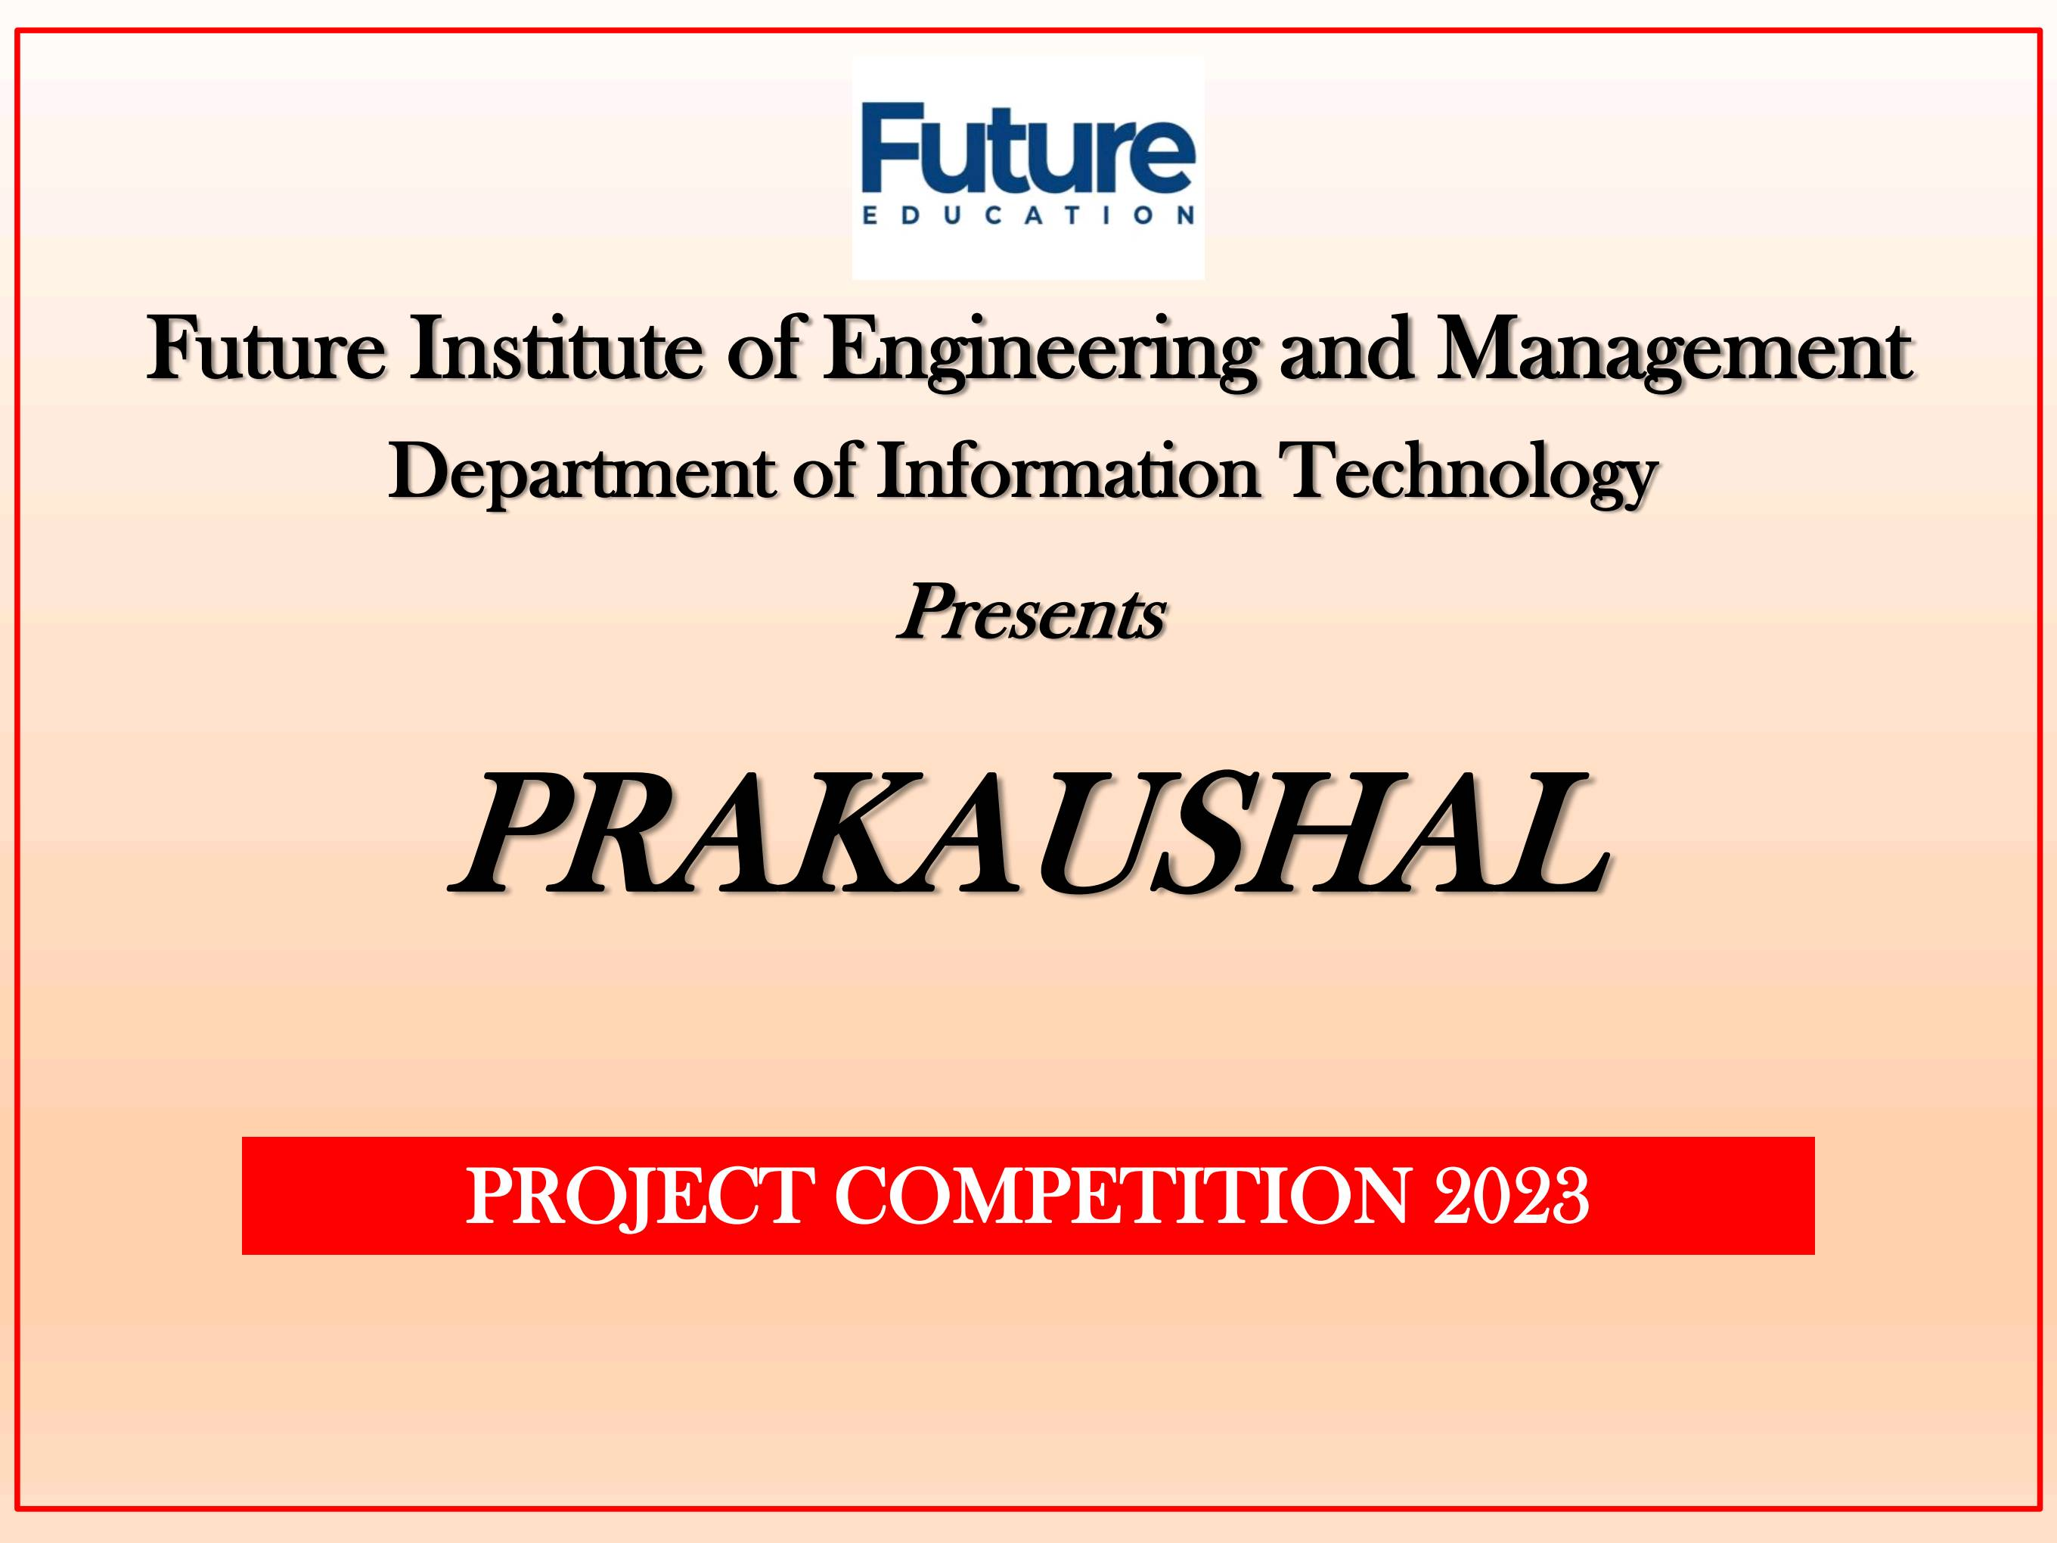

PROJECT COMPETITION 2023

Slide 2
JAVA GUI CALCULATOR
GROUP NUMBER: A
PROJECT ALLOCATION NO: 6
TEAM MEMBERS DETAILS:
Team Member 1:-
Name:-Tania Acharya Department:-IT Class Roll:-21IT43
Team Member 2:-
Name:-Pousali Chowdhury Department:-IT Class Roll:-21IT45
Team Member 3:-
Name:-Ritama Barai Department:-IT Class Roll:-21IT30
Team Member 4:-
Name:-Indranil Das Department:-IT Class Roll:-21IT87

Slide 3
Project Title:-
Design a graphical user interface for a calculator that performs all arithmetic and scientific calculations.
Project Overview:-
Java GUI calculator project is a software application that allows users to perform basic arithmetic operations (addition, subtraction, multiplication, division,modulas) and scientific operations(sin,cos,tan,factorial,square root etc) using a graphical user interface (GUI).
Project Objective:-
The objective of a Java GUI-based calculator project is to create a user-friendly software application that allows users to perform basic arithmetic operations and scientific operations(sin,cos,tan,factorial,square root etc) with ease and accuracy through a graphical interface, enhancing the user's computing experience.
Project Goals:-
The primary aim of this project are:-
1.To create a user friendly and visually appealing graphical interface that enables users to input numbers and operators easily.
2.To ensure a smooth and efficient user experience.
3.To easily perform arithmetic and scientific operations using the ‘GUI Calculator’.
4.To handle exceptions in the ‘java GUI calculator’ project’s code.

Slide 4





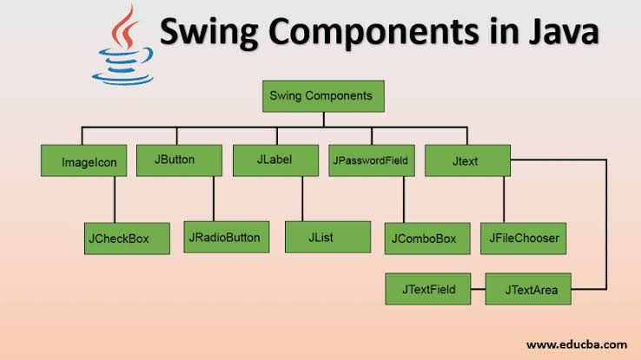
Software Requirements:-
Eclipse IDE
Java Version(Java SE-17)
JDK(Java Development Kit)
Technical Learning:-
This project helps to learn the concepts of how to use swing library in java programming language ,which provides a toolkit for building graphical user interfaces.
It also helps to understand how to handle user interactions with the components of GUI calculator using event handling,also how to handle basic arithmetic exceptions in the java programming language.
It helps to familiarize with layout managers to arrange the GUI components of the calculator in a visually appealing and functional manner.
Tech Stack:-
Programming Language: Java is the programming language for building the application.
Integrated Development Environment (IDE): Eclipse IDE is used for coding, debugging, and managing the project.
GUI Library: Swing is the graphical user interface (GUI) library in Java that provides components for creating the calculator's user interface, including buttons, text fields, and panels.
4. Event Handling: Java's event handling mechanisms, such as ActionListeners and EventListeners, are used to respond to user interactions with the GUI components like buttons and text fields.

Slide 5
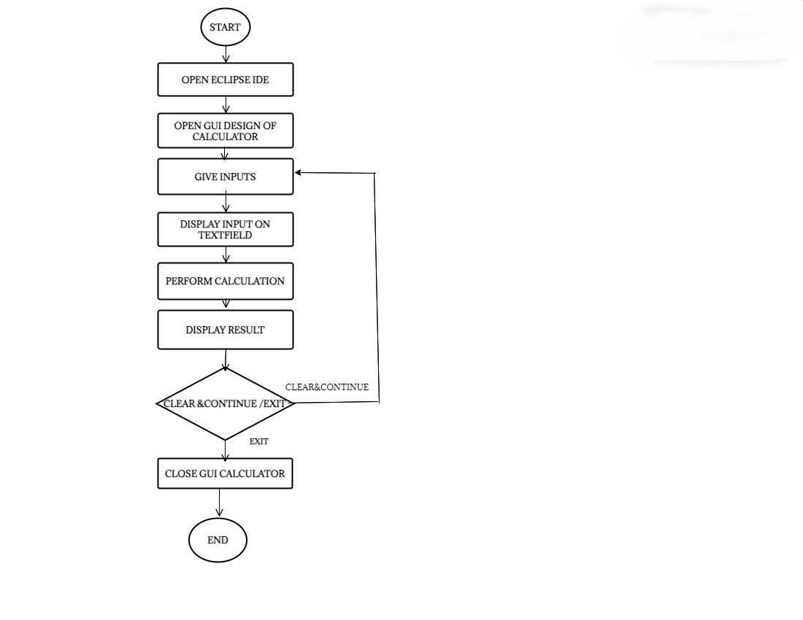
Flow Chart of ‘Java GUI Calculator’ working Model:-

Slide 6
Features of the Java GUI calculator project:-
1.Scientific Functions:- A GUI Java scientific calculator typically includes a wide range of
scientific functions such as trigonometric (sine, cosine, tangent), logarithmic, exponential,
square root, and more, making it suitable for complex mathematical calculations.
2.Exception Handling:-our project can handle the following exceptions ,if occurred while
performing calculations in the java GUI calculator:-
Example:-
Division by Zero: -When attempting to divide any number by zero, the code would catch this
exception and display "Infinity" instead of crashing the program.
Ln /Log of any Negative Number:- If a user tries to calculate the logarithm of a negative
number , the code would handle this by displaying "NaN" (Not-a-Number) instead of
producing an erroneous result.
Square Root of a Negative Number:- When taking the square root of a negative number, the
code would handle the exception gracefully by displaying "NaN" (Not-a-Number) instead of
producing an erroneous result.
3. User-Friendly Interface: -The graphical user interface (GUI) provides a user-friendly
experience with buttons, input fields, and clear displays for both input and output. Users can
easily input their calculations and view the results in a visually intuitive manner.

Slide 7
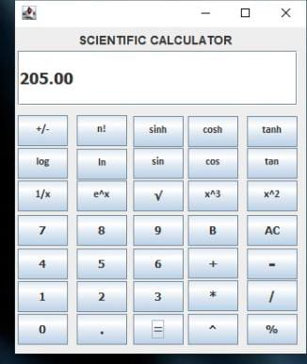
Java GUI Calculator Design:-

Slide 8
Future Enhancements:-
1.We will add memory storage capabilities, including buttons to store and recall numbers. Users
could store intermediate results or constants, which can be especially handy for complex
calculations.
2. We will incorporate unit conversion features, allowing users to convert between different
units of measurement,such as length, weight, temperature, or currency. This would make the
calculator even more practical for everyday use.
References:-
www.google.co.in
www.docs.oracle.com
www.javatpoint.com
Acknowledgement:-
We would like to express our heartfelt gratitude to our Head of Department, Mrs. Poly Sil Sen
mam, for organizing this Java project competition, providing us with a platform to showcase our
skills. We would also like to extend our sincere thanks to our java teacher, Mr. Subhasis Mitra sir,
for his invaluable guidance and support throughout the development of our Java GUI calculator
project. Additionally, we want to acknowledge the efforts of all the faculty members in the IT
department for their contributions in organizing this competition. We are grateful for their
invaluable dedication to fostering our learning and innovation .

Slide 9
THANK YOU…

